Slide 1
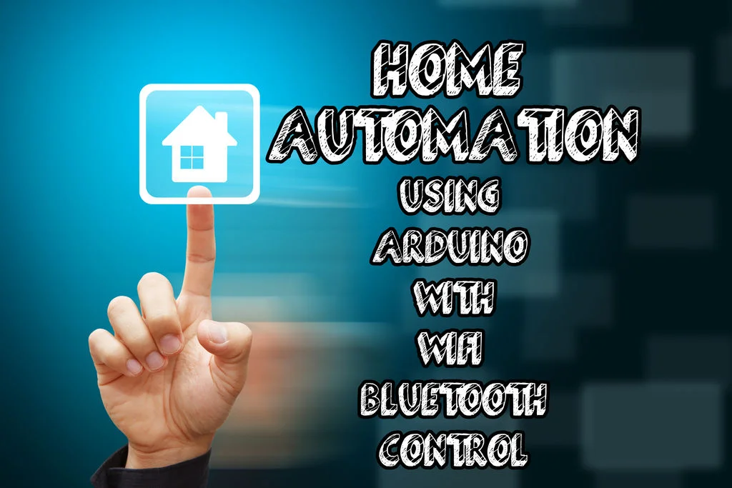

Slide 2
Team invincibles
SRIHARSHA SALUVAJI
M.R.KIRAN KUMAR
GOTTIPATI VIJAYA KUMAR

Slide 3
Overview
With headway of Automation technology, life is getting less complex and less demanding in all aspects. Home automation gives you access to control devices in your home from a mobile device anywhere in the world. Due to this technology, automatic systems are being preferred over manual systems. Internet of Things (IoT) is one of the promising technologies which can be used for connecting and monitoring your smart devices over the Internet. This project provides a effective and flexible home automation solution using an Arduino IDE, a Bluetooth module and an ESP8266 Wi-Fi module for internet connectivity.

Slide 4
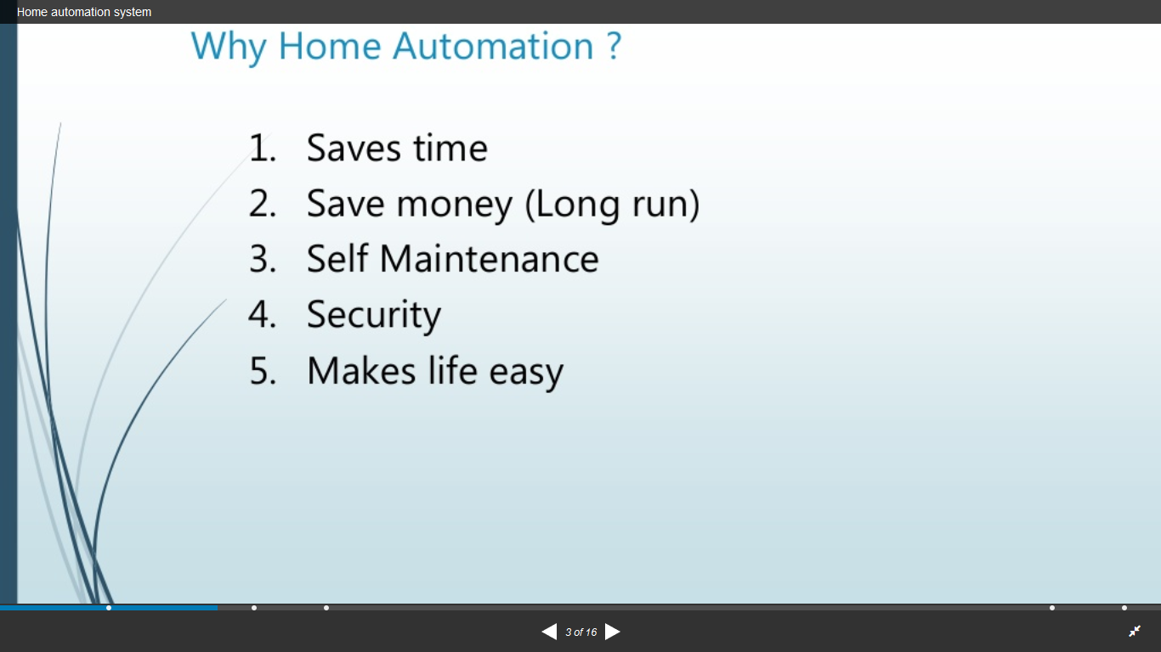

Slide 5
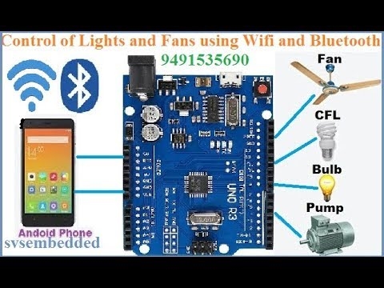
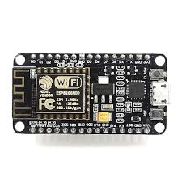

Slide 6
